Slide 1
CHALLENGES FACING WOMEN IN THE MINING, ENERGY AND CONSTRUCTION SECTORS: SURVEY REPORT
(HIGHVELD, NORTH EAST AND THE EASTERN CAPE REGIONS)
By: Dr Martin Kaggwa
Executive Research Director Sam Tambani Research Institute
HSRC, Seminar Series - 28 July 2015, Pretoria

Slide 2
Presentation Outline
Introduction and context
Methodology
Profiles of respondents
Key findings
Conclusions and way forward

Slide 3
Introduction and context
Research motivation – Establish progress made in creating women-friendly working environment in the traditionally male dominated workplaces in the 3 sectors – mining, energy and construction sectors
Key assumption - female employees generally face a different set of challenges compared to their male counterparts in the workplace
Given the desire to increase women participation, there is need to understand the specific nature of challenges women face
Contribute to national transformation policy discourse in the 3 sectors from a woman worker perspective

Slide 4
Methodology
Research methodology:
Survey
A questionnaire with 36 questions used as the tool for collecting the data
1498 women interviewed across 3 regions and 3 sectors
90% of respondents were from the mining sector

Slide 5
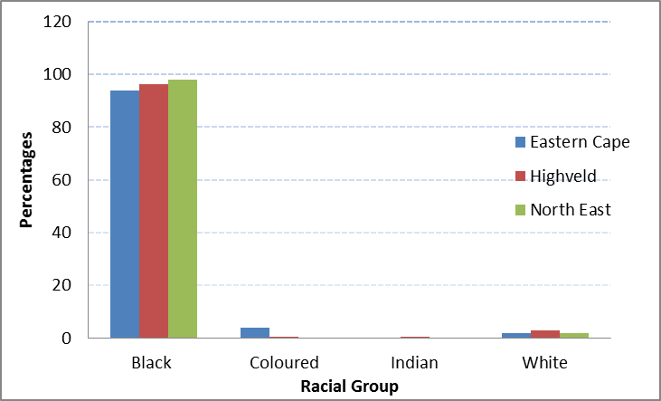
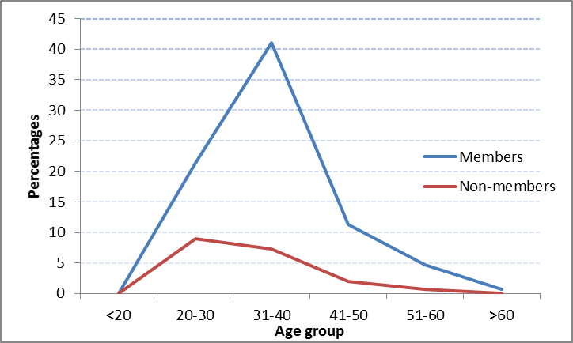
Profile of respondents
Majority of respondents were black and between the age group of 31-40 years
Figure 1: Race profile of respondents
Figure 2: Age profile of respondents

Slide 6
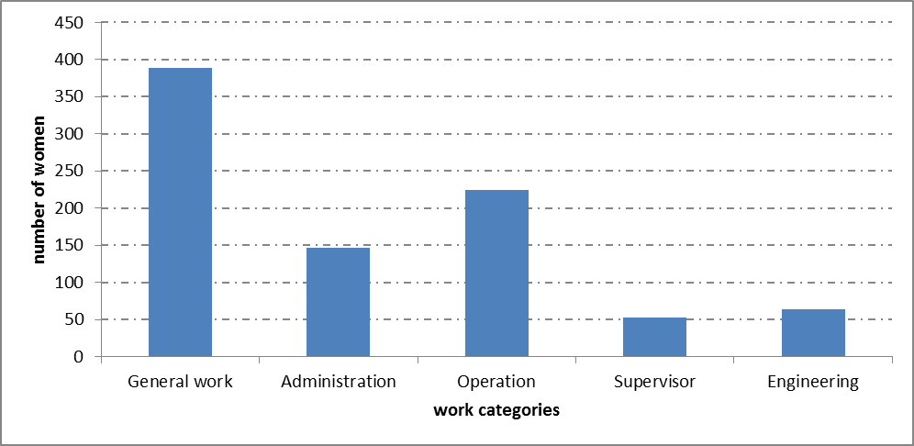
Profile of respondents: Work Positions

Slide 7
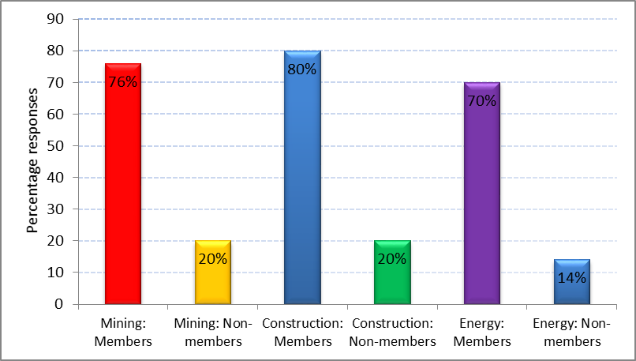
Key findings
Unionized respondents were more aware of workplace policies
Figure 3: Awareness of workplace policies – Union members versus non Union Members

Slide 8
Key findings
Lack of career guidance was the highest ranked challenge; managers the major cause of challenges
c
Type of Challenges | Percentage of Responses
Lack of career advancement | 70%
Health cover | 37%
Discrimination: Remuneration | 36%
Discrimination: Decision making | 35%
Work load | 31%
Abuse(verbal, physical, sexual) | 29%
Maternity Benefits | 27%
Lack of support from male colleagues | 25%
Family issues | 20%
Personal issues | 20%
Cause of Challenges | Percentage in terms of responses
Managers/ Supervisors | 56%
Company policies | 40%
Work load | 25%
Male colleagues | 21%
Family | 9%
Spouse | 4%
Ranking of causes for challenges faced by women in the workplace
Ranking of challenges faced by women in the workplace

Slide 9
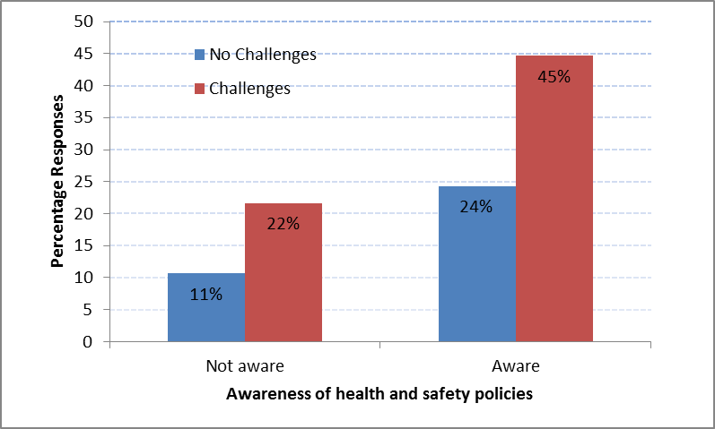
Key findings
The level of awareness safety and health challenges and existence of mitigation policies remained low across sectors

Slide 10
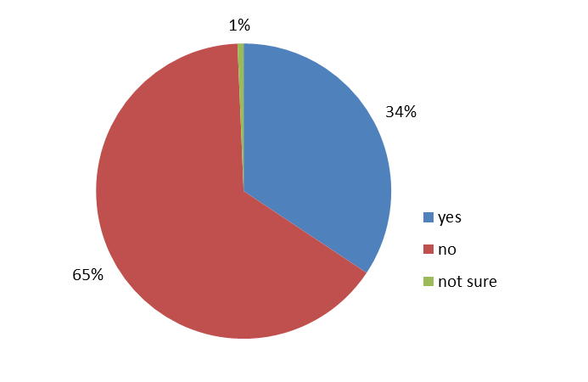
Key findings
65% of the respondents indicated that there were no initiatives done by companies to empower women
Existence of training and development initiatives to empower women

Slide 11
Key findings
68% of the respondents indicated that salary disparities existed between women and their male colleagues doing the same work
Response | Percentage
Yes | 68%
No | 30%
Existence of Salary disparities with male colleagues

Slide 12
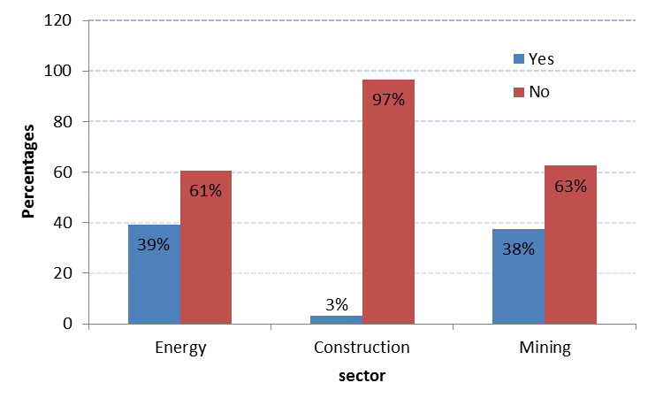
Key findings
38% respondents in the mining sector indicated awareness of incidences of sexual favours
Awareness about exchange of sexual favours taking place at the work place

Slide 13
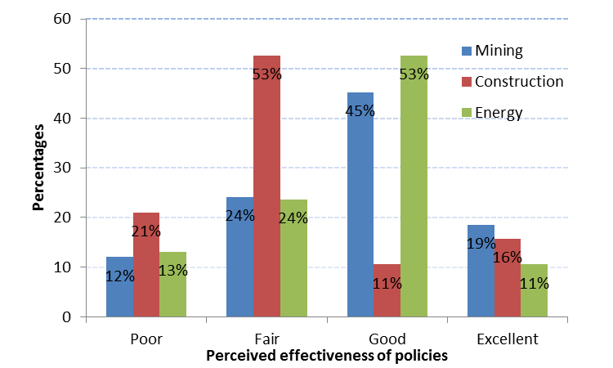
Key findings
45% of the respondents in the mining sector perceived sexual harassment policies at the work place as being effective
Perceived effective of sexual harassment policies

Slide 14
Insights and way forward
Majority of women are employed at a lower levels positions, mainly under general work category
A significant number of women (more than 35%) in the mining sector were not aware of work policies
There was a high positive correlation between Trade union membership and awareness of workplace policies.
Way forward
Interventions that increase awareness pro-women workplace policies through worker organizations have a potential to create a gender sensitive mining sector

Slide 15
Thank you!!!

