Slide 1
Can mining, sustainable development and mitigating effects of climate change be mutually inclusive? A reflection on South Africa’s situation.
Martin Kaggwa
Sam Tambani Research Institute

Slide 2
Outline
Introduction
South Africa’s 2030 Development Agenda
Mining and sustainable development for South Africa from a systems thinking perspective
A qualitative system dynamics model of mining, climate change and Sustainable Development
Insights from the qualitative SD model of mining, sustainable development and climate change
Conclusion

Slide 3
Introduction
Central to Sustainable Development (SD) is the improvement of people’s welfare in perpetuity
SD is based on the understanding that development of any country depletes a country’s resources needed to sustain it
Implementation of development initiatives often has unintended negatives developing over time such as climate change
Achieving higher levels of economic growth is a necessarily but not sufficient condition for SD
To achieve SD, natural-resource rich countries have to exploit these resources to trigger the required economic growth!
Exploiting the natural resources is inherently non-sustainable

Slide 4
South Africa’s 2030 Development Agenda
South Africa’s SD aspirations are espoused in its 2030 Development Agenda guided by National Development Plan (NDP)
It is believed that the country has adequate resources to realise sustainable development
To achieve the paramount objective of poverty reduction and eliminate inequality of part of SD, the NDP sets out intermediary objectives:
    Growing, job-creating and an all-inclusive economy
    Place physical infrastructure
    Improving the quality of education
    Position the country strategically in relation to global economic business
    Transition the local economy to a low carbon economy
    The mining sector is expected to play an important role in the achievement of these intermediary objectives BUT how is this possible in the context of SD?

Slide 5
The mining sector in South Africa and sustainable development from a systems thinking perspective
A systems thinking approach was used to answer whether mining, mitigating effects of climate change and subsequently SD can be mutually inclusive
Systems thinking makes explicit key relations in a policy framework and facilitates the elimination of internal inconsistences and contradictions
The approach also introduces the elements of feedback effects and nonlinearities overtime which are critical elements in holistic policy articulation.
For policy analysis, important relationships between mining, SD, the environment and subsequently climate change could thus be captured by a model based on systems thinking.

Slide 6
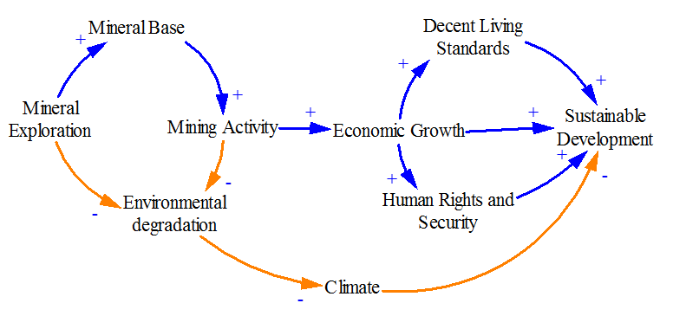
A qualitative system dynamics model of mining, climate change and Sustainable Development
The Qualitative System Dynamic Model (SD)

Slide 7
Insights from the qualitative SD model of mining, sustainable development and climate change
To make mining a more reliable contributor to sustainable development, two interventions were introduced to the model:
Investment in mineral exploration to prolong the lifetime of mining explorations
Investment of income generated from mining in other sustainable sectors of the economy e.g tourism, agriculture, specialised human training
NB: The private sector and/or government have to take a conscious decision to invest in exploration and other sustainable sectors

Slide 8
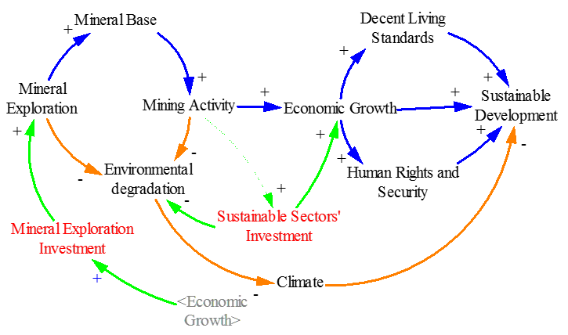
System Dynamic Model Cont..
System Dynamic Model

Slide 9
Conclusion
Mining activity and its contribution to sustainable development are not sustainable.
For mining to effectively support sustainable development in South Africa, the country must invest some of the revenue generated from mining to other sectors of the economy whose existence will go beyond the lifetime of mining.
In mitigating the effects of mining to climate, cleaner mining technologies need to be sought and applied.

